Slide 1
AUTONOMOUS MACHINE LEARNING MODELING USING A TASK ONTOLOGY
Presented by:
Chamakuri Prasad
Reg.no: 17A21F0004
MCa
Under the guidance of
A.N.L.Kumar, MCA ,M.Tech
Associate Professor, Department of MCA

Slide 2
Abstract
The artificial intelligence technology is currently used in almost all industries and many machine learning experts are working on combining and standardizing different machine learning tools so that non-experts will also easily apply them to their particular domain.
This project has two types of functionalities
First one is take the image input from the user then processing that image it will find object names in the image.
Second one is take the text(sample.txt) file input from the user then processing that text file it will find the meaning to every word. .
The technical terminology can separate typical problem-solving steps for autonomous machine learning as tasks and present a problem-solving process.

Slide 3
INTRODUCTION
Artificial intelligence technology has become one of the most essential tools in research and business context recently.
Most of the machine learning frameworks are open-source, so the entry of barriers into machine learning.
programming languages such as Python, Java, and R. In this respect, many machine learning experts are working on integrating and standardizing various tools so that machine learning nonexperts can easily apply them to their domains.
The tools of autonomous machine learning provide an optimal algorithm for machine learning tasks and functions to determine the hyper-parameter setting through self-analysis
The purpose of the proposed autonomous machine learning model is to model autonomous machine learning by reusing existing resources and producing new knowledge through relearning it

Slide 4
Task ontologies
Ontology is defined in various fields depending on the field of applications. In the field of artificial intelligence, it is an explicit and formal specification of how objects and concepts described in the field of interest.
Machine learning ontologies
ML schema is a top-level ontology that provides classes, properties, and constraints for machine learning algorithms, datasets and experimentation
Autonomous machine learning modelling
Autonomous machine learning modeling is the work for standardization and abstraction to the core of the components base on the meta information of the machine learning.

Slide 5
FUNCTIONAL REQUIREMENTS:
Functional requirements are important to construction your requirement creation. A functional requirement document helps you to define the functionality of a system or one of its subsystems.
➢ Admin
• Login
• View User Data
• User Activation
• Logout

Slide 6
➢ User
• Registration(Login)
• Upload Text
• Upload Images
• Find Vocabulary
• Detecting Objects
• Logout

Slide 7
They are two algorithms Used in these Project
Convolutional Neural Networks:
Convolutional Neural networks are designed to process data through multiple layers of arrays. This type of neural networks is used in applications like image recognition or face recognition. The primary difference between CNN and any other ordinary neural network is that CNN takes input as a two-dimensional array and operates directly on the images rather than focusing on feature extraction which other neural networks focus on.
k nearest neighbors:
K nearest neighbors is a simple algorithm that stores all available cases and classifies new cases based on a similarity measure (e.g., distance functions). KNN has been used in statistical estimation and pattern recognition.

Slide 8
Non-functional Requirements:
A non-functional requirement is a requirement that specifies criteria that can be used to judge the operation of a system, rather than specific behaviors. The following are the important nonfunctional requirements including our system.
Security
The system provides more security to the users. Only authorized users can access the system. The authorization can be given by the cloud server to the users and owners. The system is having a priority role in keeping the privacy of the user.
Reliability:
The System should be reliable and must not degrade the performance of the existing system and should not lead to the hanging of the system.
Accuracy:
The level of accuracy is very high. All the operations would be done well. The system can perform accuracy in uploading and downloading the files

Slide 9
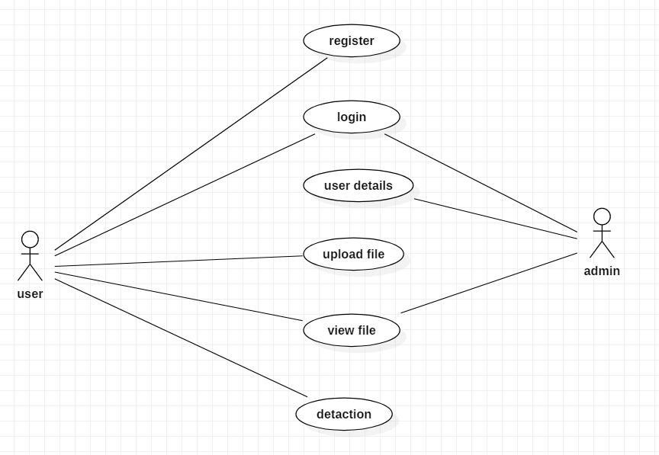
Use Case Diagram:

Slide 10
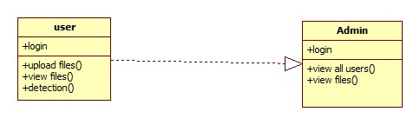
5.4.1 Class Diagram:

Slide 11
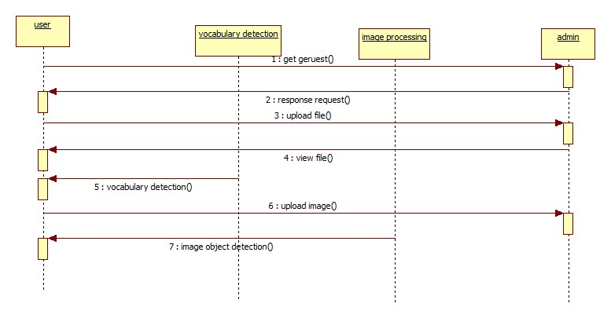
Sequence Diagram:

Slide 12
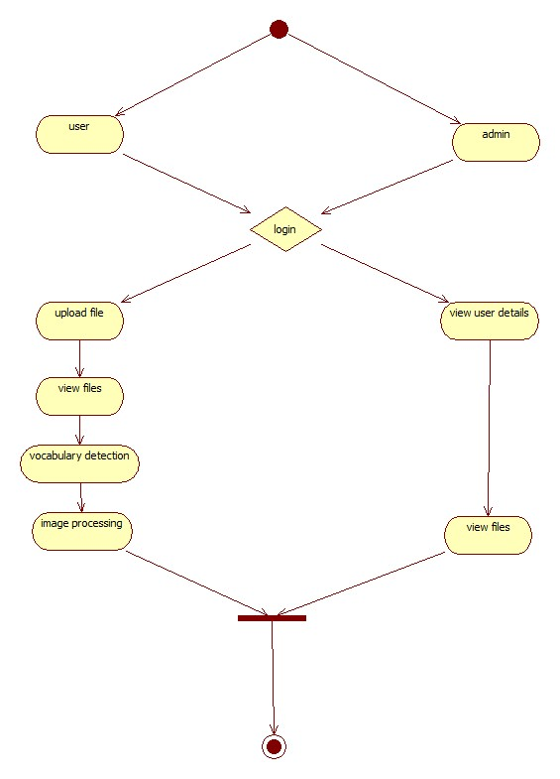
Activity Diagram:

Slide 13
Database Design
User Registration
S. No | Field | Data Type | Size | Constraint
1 | Login ID | Varchar | 30 | Primary Key
2 | Mail | Varchar | 30 | Not Null
3 | Password | Varchar | 20 | Not Null
4 | Mobile | Varchar | 10 | Not Null
5 | Place | Varchar | 30 | Not Null
6 | City | Varchar | 30 | Not Null
User Login
S. No | Field | Data Type | Size | Constraint
1 | Login ID | Varchar | 30 | Primary Key
2 | Password | Varchar | 30 | Not Null
3 | image | LONGBLOB | Below 1MB | Not Null
4 | Text | Varchar | 150 | Not Null

Slide 14
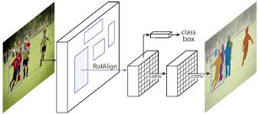
System Architecture:

Slide 15
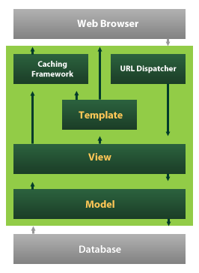
SYSTEM IMPLEMENTATION
Python:
Python is a general-purpose interpreted, interactive, object-oriented, and high-level programming language.
Django:
Django is a high-level Python Web framework that encourages rapid development and clean, pragmatic design.

Slide 16
Modules of the Python
Pillow :
Pillow is a Python Imaging Library (PIL), which adds support for opening, manipulating, and saving images. The current version identifies and reads a large number of formats.
Numpy :
NumPy is an open-source numerical Python library.
NumPy contains a multi-dimensional array and matrix data structures.
It can be utilized to perform a number of mathematical operations on arrays such as trigonometric, statistical, and algebraic routines.
NLTK :
Natural Language Processing with Python NLTK is one of the leading platforms for working with human language data and Python, the module NLTK is used for natural language processing. NLTK is literally an acronym for Natural Language Toolkit.

Slide 17

outputs
Home Page

Slide 18
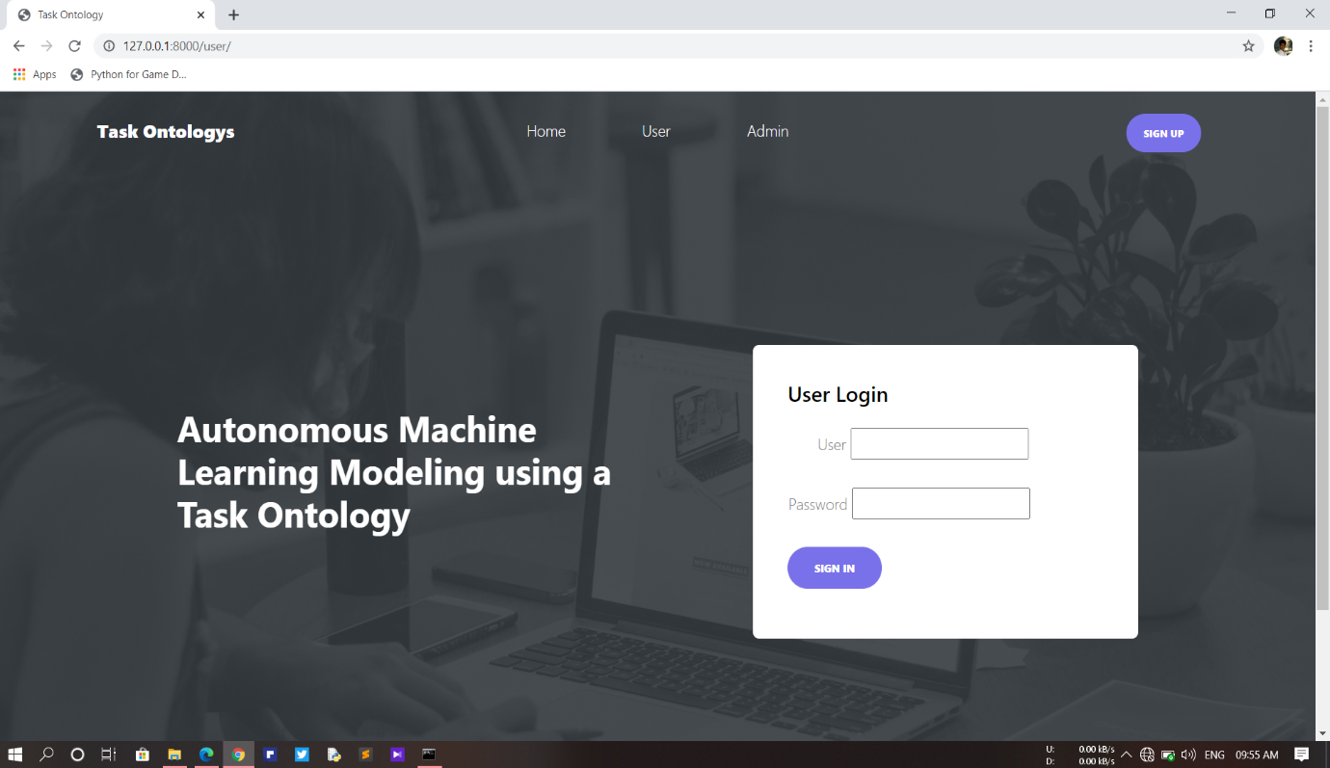
User login

Slide 19
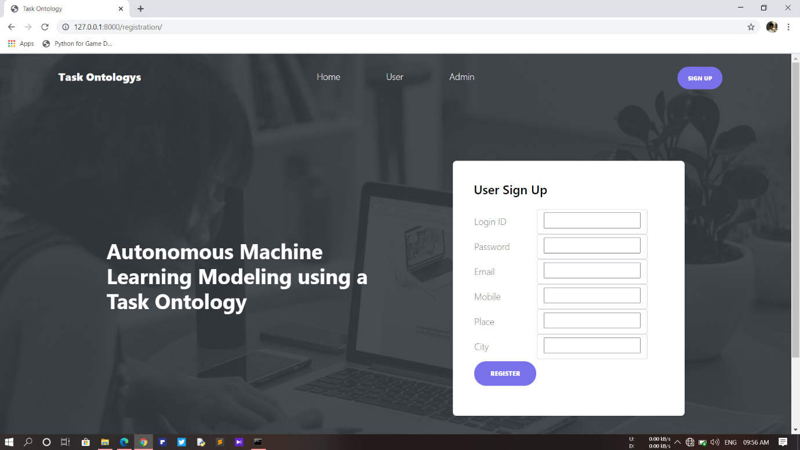
User register

Slide 20
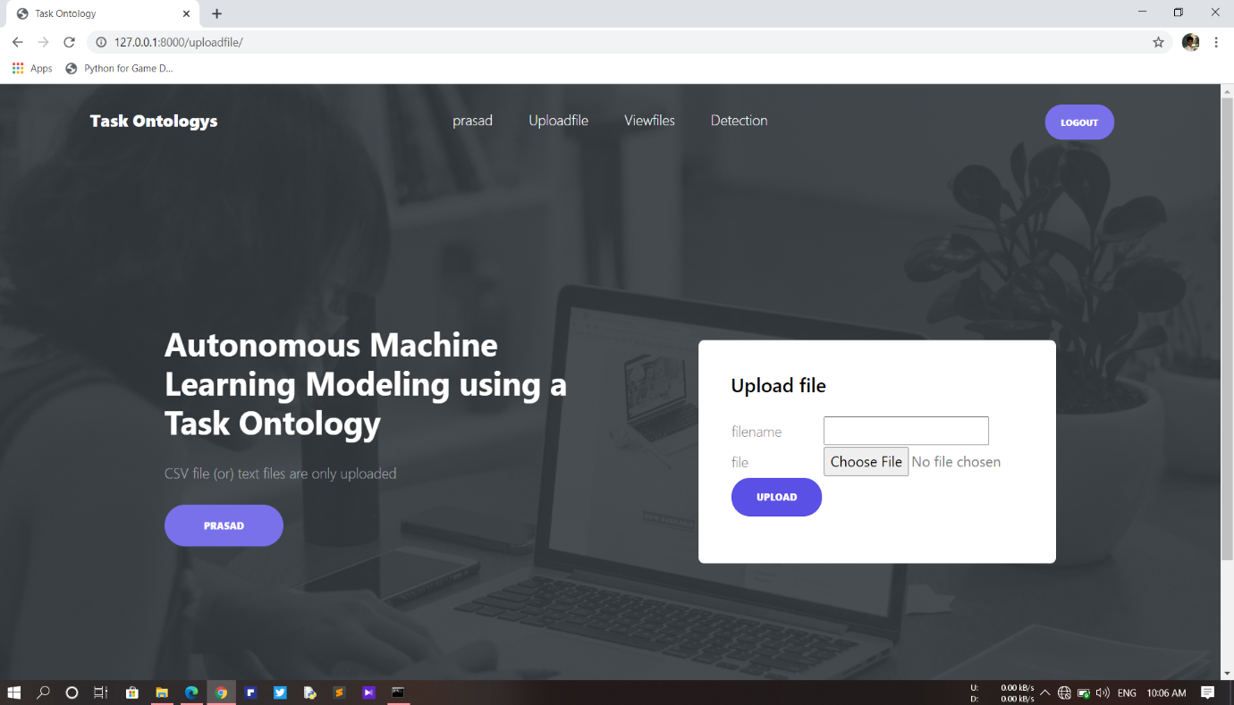
User upload file

Slide 21
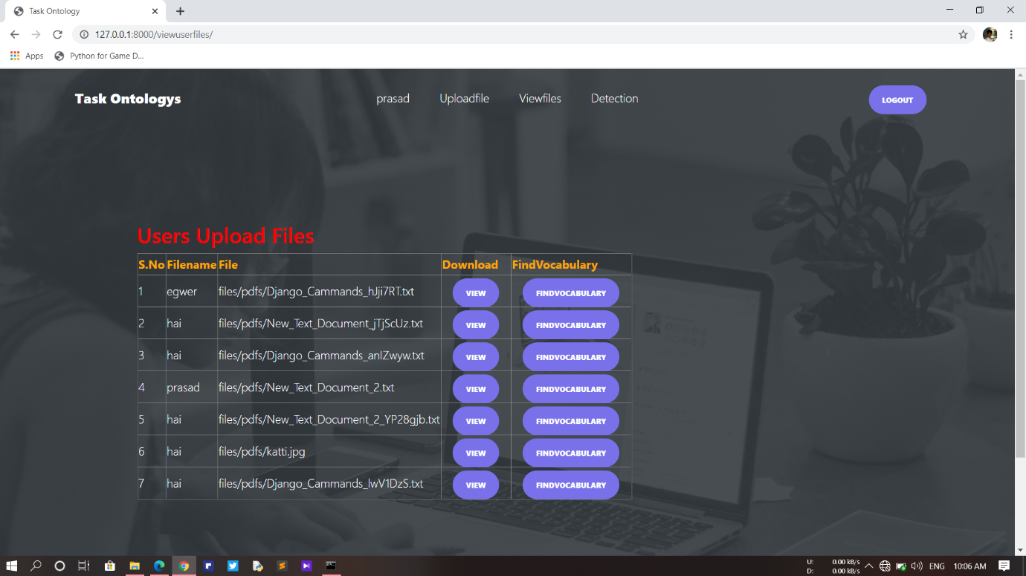
User view file

Slide 22
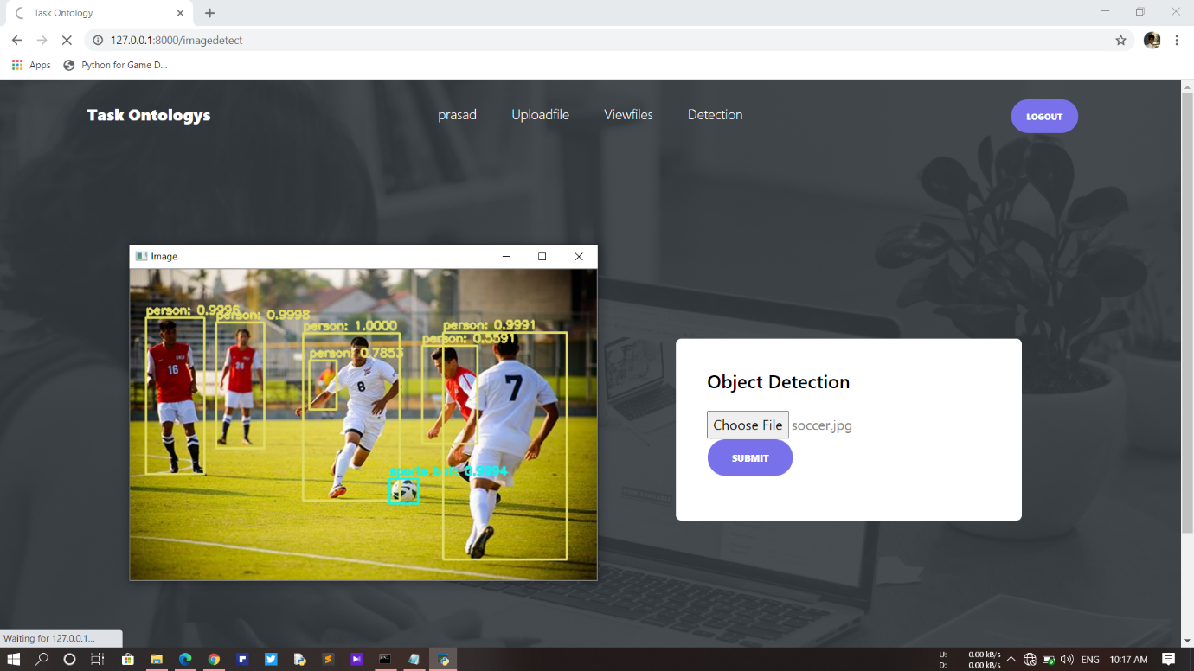
Image detection

Slide 23
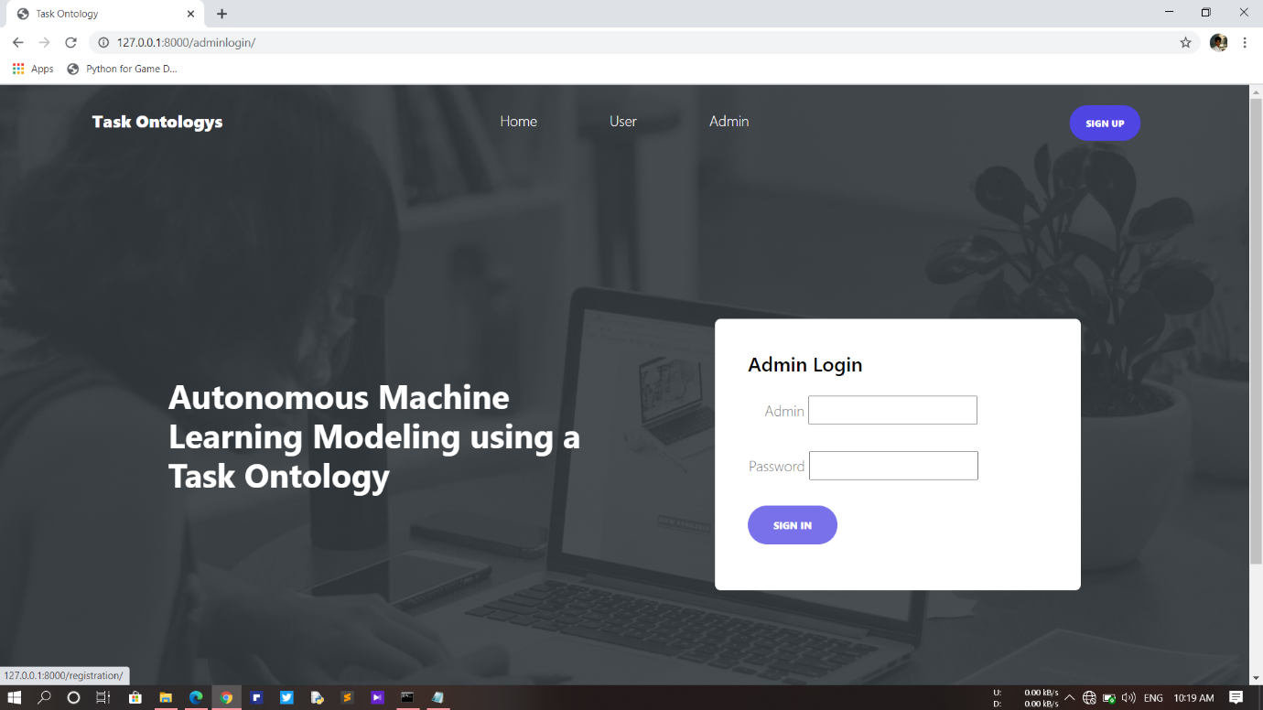
Admin Login

Slide 24
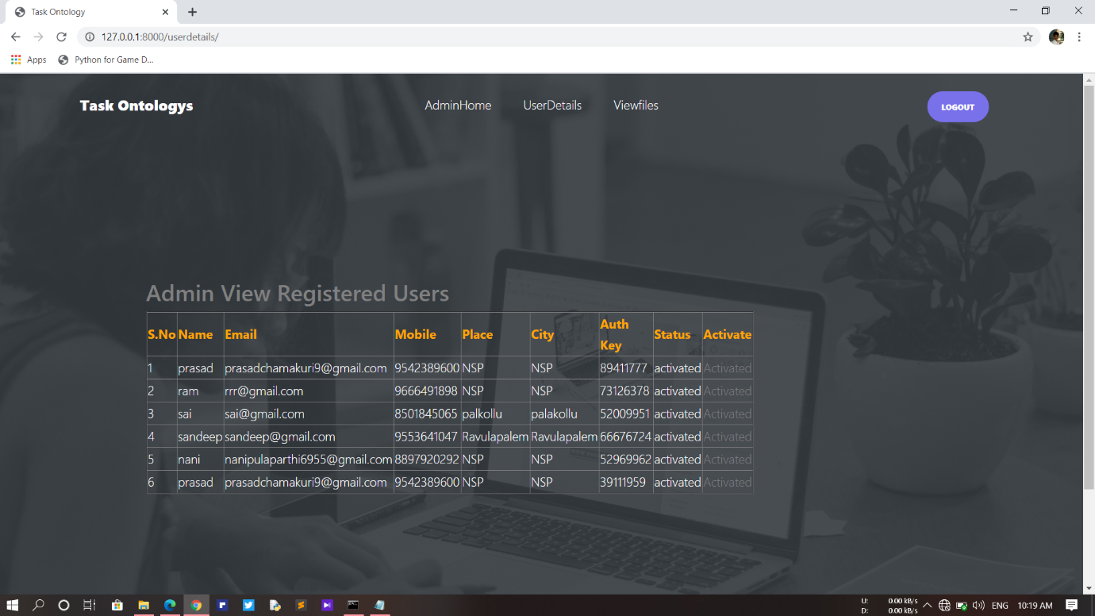
User details

Slide 25

View files

Slide 26
CONCLUSION
In this project, we extracted important keywords for constructing an ontology from papers and textbooks about machine learning. we could be implemented object recognition from the image. Moreover, we designed a task ontology based on the MEX vocabulary. We also studied workflow for the autonomous machine learning model. The proposed method is applicable for automatic workflow according to designated autonomous level. Therefore, the non-experts are capable of doing complex tasks using the proposed method and can easily implement the machine learning model in a specific application.

Slide 27
Thank You

